Slide 1
Sakila Rental Store Movie Rental Data Analysis Capestone Project Divyansh Kumar Gupta Mentor-Shruti Gode

Slide 2
Description
Sakila is a movie rental store with a wide collection of movies in DVDs and blue ray disc formats. The management decided to analyze the data to understand that what sort of movies and actors are popularly rented.
The analysis would help them stock up the inventory of movies to improve their business. This analysis involves a set of tasks to commence with as an analyst.
OBJECTIVES:
The analysis would help the management to stock up the inventory as per the most popular movies and actors.
The motive of analysis would also help the management to maximize the overall rental sales.
The final report would give the overview of the current inventory in stock.

Slide 3
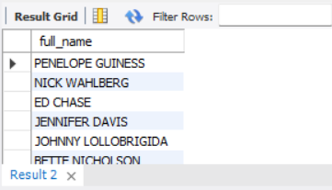
Movie Rental Data Analysis
Task 1: Display the full names of actors available in the database.
Interpretation: Displays the full concatenated names of the actors.

Slide 4
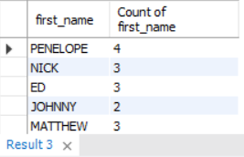

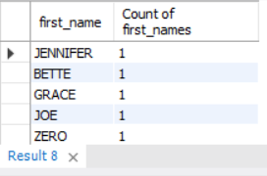
Movie Rental Data Analysis
Task 2: Management wants to know if there are any names of the actors appearing frequently.
i. Display the number of times each first name appears in the database. ii. What is the count of actors that have unique first names in the database? Display the first names of all these actors.
Interpretation: There are total 128 actors with distinct first names.

Slide 5
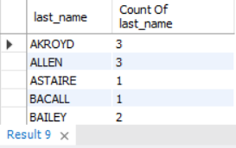
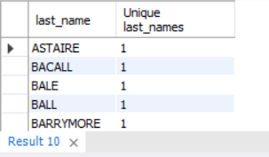
Movie Rental Data Analysis
Task 3: The managment is interested to analyze the similarity in the last names of the actors.
i. Display the number of times each last name appears in the database.ii. Display all unique last names in the database.
Interpretation: Displays the last names of the actors with count and actors with distinct last names.

Slide 6
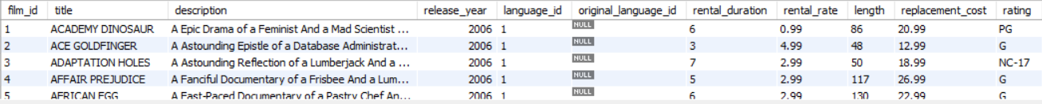
Movie Rental Data Analysis
Task 4: The management wants to analyze the movies based on their ratings to determine if they are suitable for kids or some parental assistance is required.Perform the following tasks to perform the required analysis.i. Display the list of records for the movies with the rating "R".(The movies with the rating "R" are not suitable for audience under 17 years age.ii. Display the list of records for movies that are not rated "R".iii. Display the list of records for movies that are suitable for audience below 13 years of age.
Interpretation: Displays the records of films with ‘R’for restricted for family rating and also ‘G’ for general

Slide 7
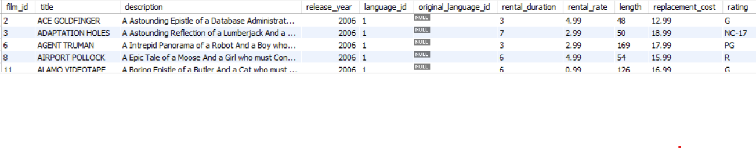
Movie Rental Data Analysis
Task 5 : The board members wants to understand the replacement cost of a movie copy(disc- DVD/Blue Ray).The replacementt cost refers to the amount chargerd to the customers if the movie disc is not refunded or is returned in a damage state.i. Display the list of records for the movies where the replacement cost is up to $11.ii. Display the list of records for the movies where the replacemnt cost is between $11 and $20.iii. Display the list of records for all the movies in descending order of their replacement costs.
Interpretation: Displays the records of films with replacement cost upto $11, between $11 to $20 and sorted in descending order on the basis on replacement cost

Slide 8
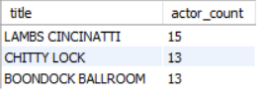
Movie Rental Data Analysis
Task 6 Display the names of top 3 movies with greatest number of actors.
Interpretation: ‘Lambs Cincinatti’ is the movie with highest count of actors

Slide 9
Movie Rental Data Analysis
Task 7: 'Music of Queen and Kris Kristofferson' have seen an unlikely resurgence. As an unintended consequence, films starting with the letters 'K' and 'Q' have alsosoared in popularity. Display the titles of the movies starting with letters 'K' and 'Q'.
Interpretation: Movies like ‘Kane Exorcism’, ‘QUILLS BULL’ etc starts with the letter K or Q

Slide 10
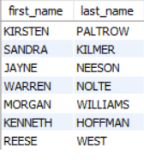
Movie Rental Data Analysis
Task 8 : The film 'Agent Truman' has been a great success. Display the names of all actors who appeared in this film.
Interpretation: Actors like ‘Kirsten Paltrow’, ‘Sandra Kilmer’ etc. were the part of the cast for the movie ‘Agent Truman’

Slide 11
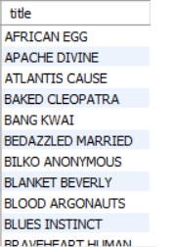
Movie Rental Data Analysis
Task 9: Sales have been lagging amoung young families, so the management wants to promote family movies. Identify all movies categorized as family films.
Interpretation: Movies like ‘ African Egg’, ‘Apache Divine’, ‘ Atlantis Cause’ etc are categorized for family

Slide 12
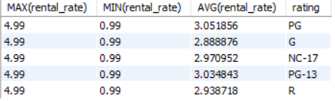
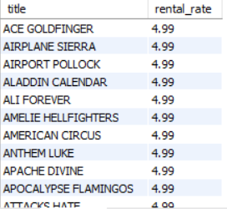
Movie Rental Data Analysis
Task 10: The managment wants to observ the rental rates and rental frequencies(Number of time the movie disc is rented). i. Display the maximum, minimum and average rental rates of movies based on their ratings. The output must be sorted in descending order of the average rental rates. ii. Display the movies in descending order of their rental frequencies, so the management can maintain more copies of these movies.
Interpretation: Displays the maximum, minimum and average rental rates of different rating category also movies like ‘Ace Goldfinger’, ‘Airplane Sierra’ etc. have the highest rental rates

Slide 13
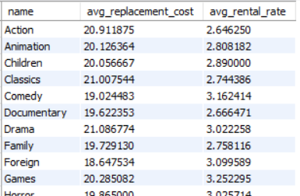
Movie Rental Data Analysis
Task 11: In how many film categories, the difference between the average film replacement cost ((disc - DVD/Blue Ray) and the average film rental rate greater than $15? Display the list of all film categories identified above, along with the corresponding average film replacement cost and average film rental rate.
Interpretation: All the categories have the difference of average replacement cost and average rental rate i.e, $17 greater that $15

Slide 14

Movie Rental Data Analysis
Task 12: Display the film categories in which the number of movies is greater than 70.
Interpretation: Only categories like ‘Foreign’ and ‘Sports’ that consist of highest number of movies

Slide 15


